Slide 1

Algebra 1
Unit 9, Lesson 8 Isolating a Quantity of Interest in a Quadratic Equation Volume 2, pg. 98

Slide 2


Benchmark
MA.912.AR.1.2
Rearrange equations or formulas to isolate a quantity of interest.
volume 2, pg. 98

Slide 3
Integrated Mathematical Thinking and Reasoning Standards
MA.K12.MTR.1.1 Actively participate in effortful learning both individually and collectively.
MA.K12.MTR.2.1 Demonstrate understanding by representing problems in multiple ways.
MA.K12.MTR.3.1 Complete tasks with mathematical fluency.
MA.K12.MTR.4.1 Engage in discussions that reflect on the mathematical thinking of self and others.
MA.K12.MTR.5.1 Use patterns and structure to help understand and connect mathematical concepts.
volume 2, pg. 98

Slide 4

Learning Targets
I can rearrange the vertex form of a quadratic equation to isolate a variable of interest.
I can rearrange the factored form of a quadratic equation to isolate a variable of interest.
I can rearrange the standard form of a quadratic equation to isolate a variable of interest.
volume 2, pg. 98

Slide 5

Warm-Up
volume 2, pg. 98

Slide 6
9.8.1 Warm-Up: Bell Work
Solve $2x^{2}−12x+14=2x−6$ by factoring.
volume 2, pg. 98
Notes:
Video Link: https://algebranation.wistia.com/medias/fi4fidi5y8

Slide 7

Collaboration
volume 2, pg. 99

Slide 8


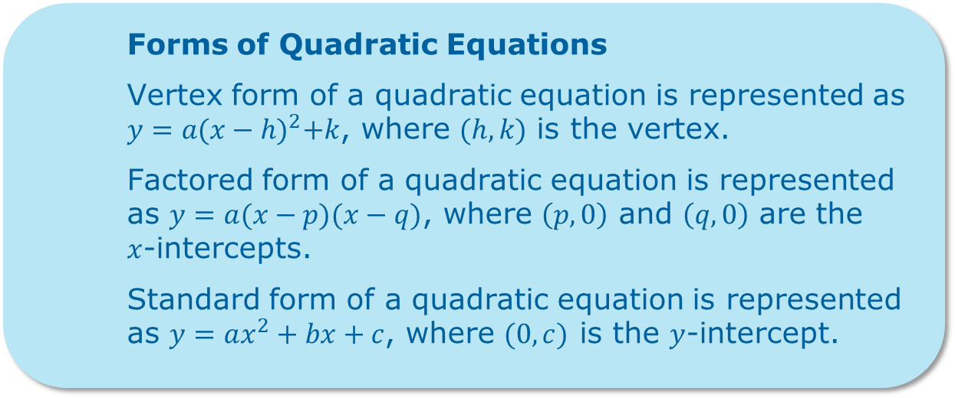
9.8.2 Collaboration: Forms of Quadratic Equations
The three different forms of quadratic equations are helpful in providing information about key features of the parabola. It may be helpful at times to understand how a quadratic equation can be rewritten to feature a specific variable.
Forms of Quadratic Equations
Vertex form of a quadratic equation is represented as $y=a{(x−h)}^{2}+k$, where $(h,k)$ is the vertex.
Factored form of a quadratic equation is represented as $y=a(x−p)(x−q)$, where $\left(p,0\right)$ and $\left(q,0\right)$ are the $x$-intercepts.
Standard form of a quadratic equation is represented as $y=ax^{2}+bx+c$, where $(0,c)$ is the $y$-intercept.
volume 2, pg. 99

Slide 9
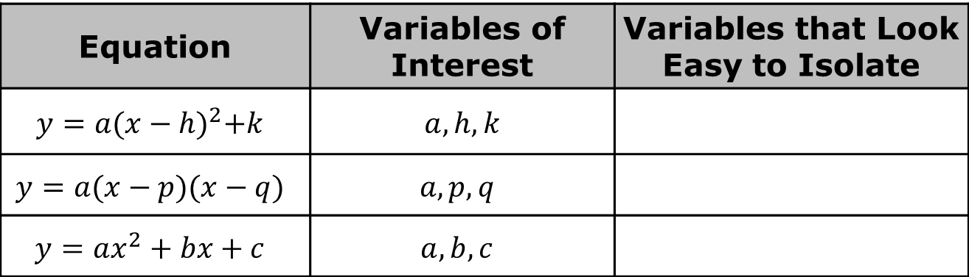
Work with your partner to complete the table.
Equation | Variables of Interest | Variables that Look Easy to Isolate
$$y=a{(x−h)}^{2}+k$$ | $$a, h, k$$
$$y=a(x−p)(x−q)$$ | $$a, p, q$$
$$y=ax^{2}+bx+c$$ | $$a, b,c$$
volume 2, pg. 99

Slide 10
Each partner should ask two different classmates which variables they selected. Record their variables and write your summary of their reasons. You are the only person who should write in the first two columns of the table. Have the person initial next to your summary stating that your summary was correct.
Variables That Look Easy to Isolate | My Summary of their Reason | Initials
volume 2, pg. 99

Slide 11
The variable 𝑎 is the only variable that is common to all three forms. Which form appears to be the easiest to use to isolate the variable 𝑎?
volume 2, pg. 99

Slide 12
Collaboration
volume 2, pg. 100

Slide 13

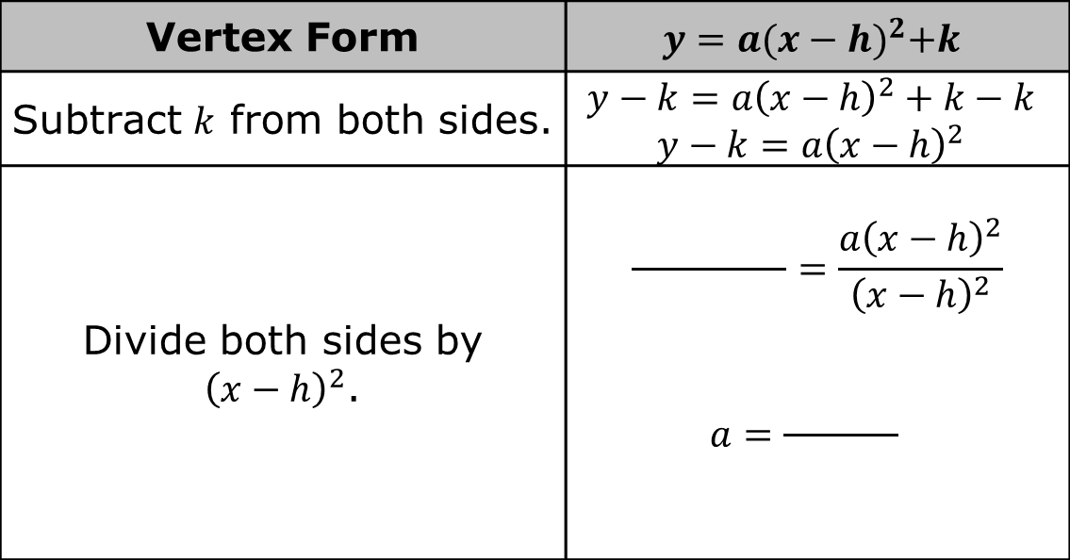
9.8.3 Collaboration: Isolating the Variable $a$
Work with your partner to complete the steps for isolating the variable 𝑎.
Vertex Form | $$y=a{(x−h)}^{2}+k$$
Subtract $k$ from both sides. | $$y−k=a{\left(x−h\right)}^{2}+k−k$$ $$y−k=a{\left(x−h\right)}^{2}$$
Divide both sides by ${\left(x−h\right)}^{2}$. | $$\frac{ }{ }=\frac{a{\left(x−h\right)}^{2}}{{\left(x−h\right)}^{2}}$$ $a=\frac{ }{ }$
volume 2, pg. 100

Slide 14
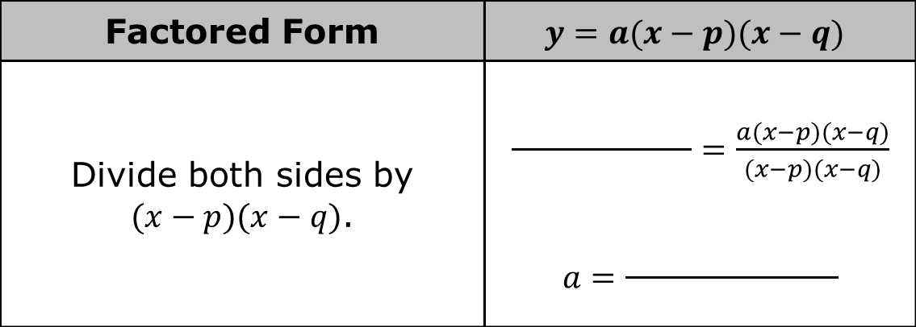
Factored Form | $$y=a(x−p)(x−q)$$
Divide both sides by $(x−p)(x−q)$. | $\frac{ }{ }=\frac{a(x−p)(x−q)}{(x−p)(x−q)}$ $$a=\frac{ }{ }$$
volume 2, pg. 100

Slide 15
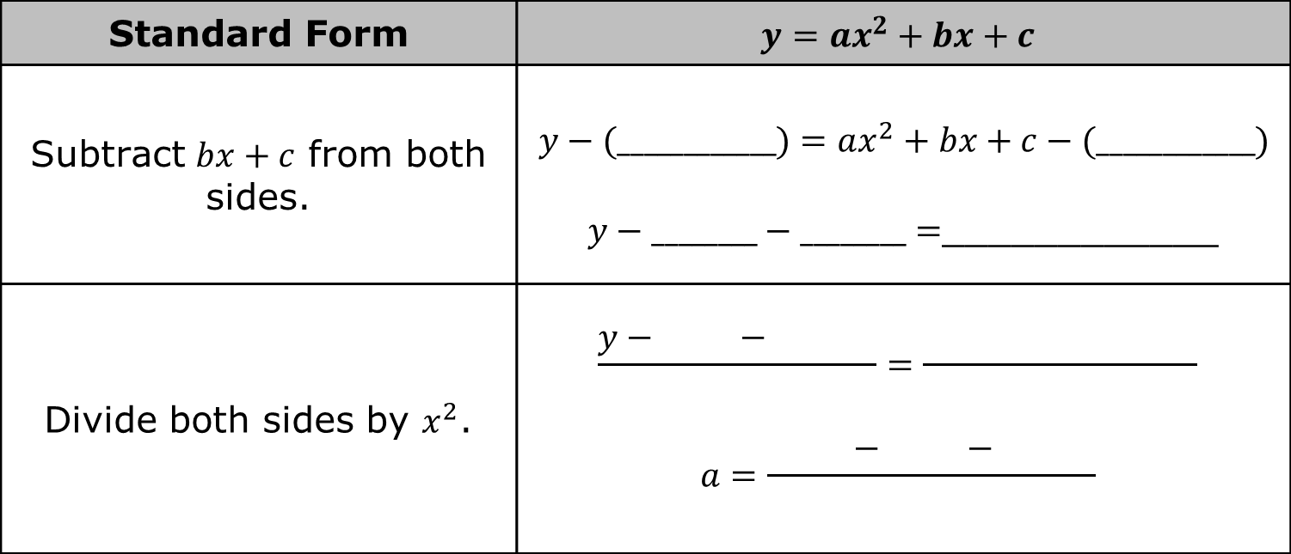
Which form, if any, was the easiest to use to isolate the variable 𝑎?
Standard Form | $$y=ax^{2}+bx+c$$
Subtract $bx+c$ from both sides. | $$y−(____________)=ax^{2}+bx+c−(____________)$$ $y−________−________=$____________
Divide both sides by $x^{2}$. | $$\frac{y− − }{ }=\frac{ }{ }$$ $$a=\frac{ − − }{ }$$
volume 2, pg. 100

Slide 16

Guided Instruction
volume 2, pg. 101

Slide 17


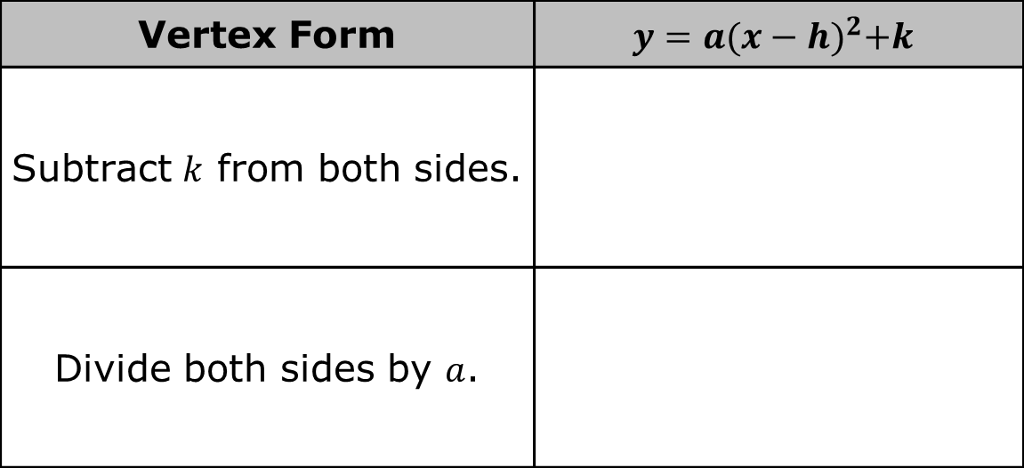
9.8.4 Guided Instruction: Isolating the Variable $x$
Complete the table for isolating the variable 𝑥 in vertex form.
Vertex Form | $$y=a{(x−h)}^{2}+k$$
Subtract $k$ from both sides.
Divide both sides by $a$.
volume 2, pg. 101

Slide 18

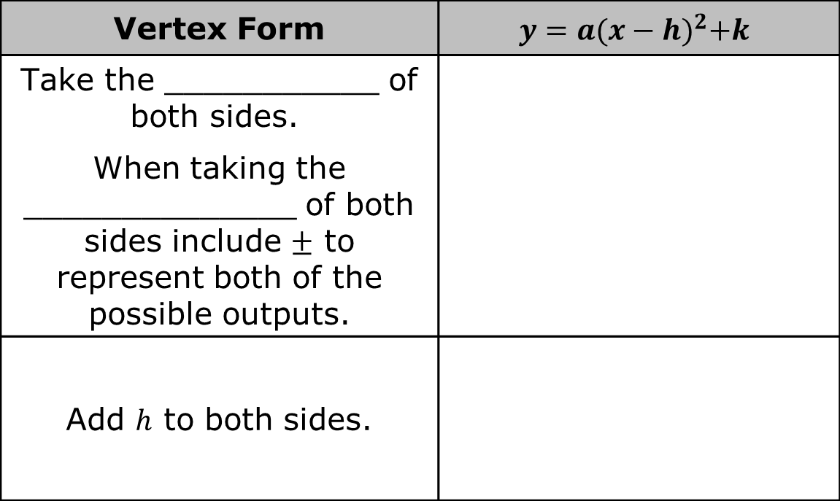
The $±$ represents both possible results of a square root. Remember, when asked to find $\sqrt{36}$ it is understood that the principal square root, $6$, is the answer, but that both $6$ and $−6$ are correct because both values can be multiplied by itself to get $36$. This can be written as $\sqrt{36}=±6$.
Vertex Form | $$y=a{(x−h)}^{2}+k$$
Take the ___________ of both sides. When taking the ______________ of both sides include $±$ to represent both of the possible outputs.
Add $h$ to both sides.
volume 2, pg. 101

Slide 19
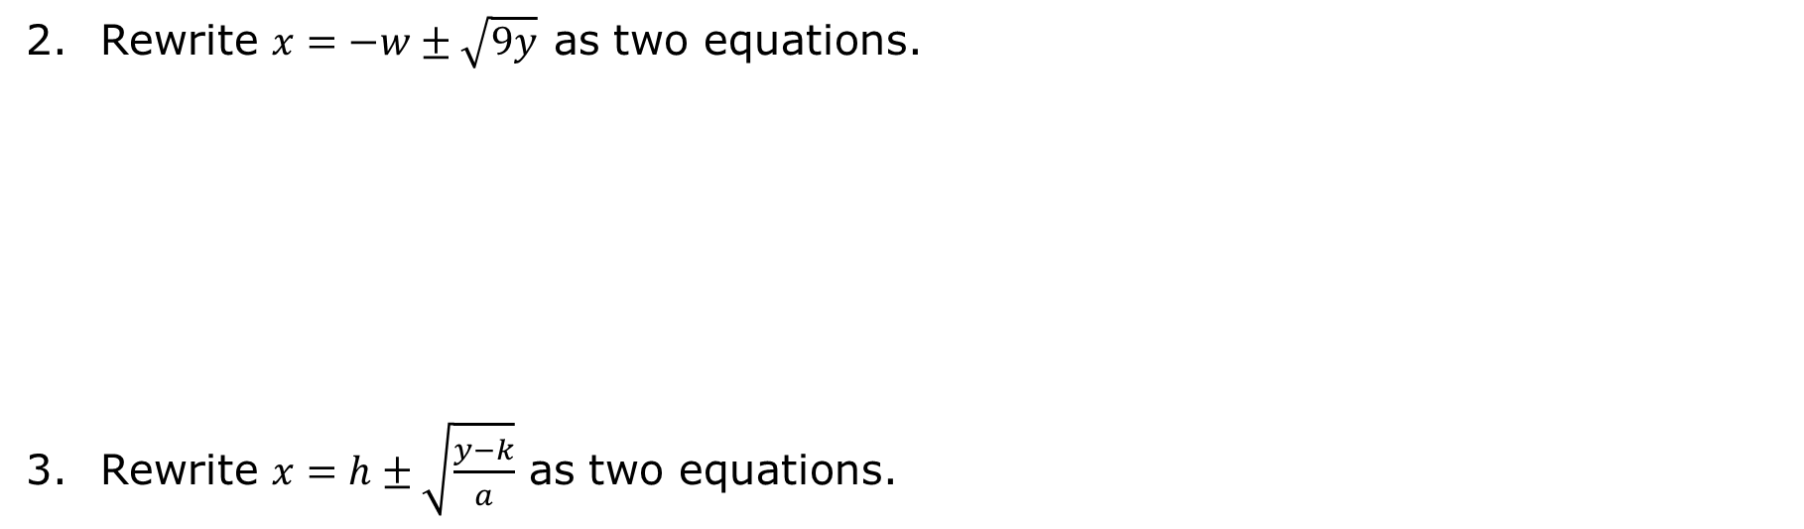
Rewrite $x=−w±\sqrt{9y}$ as two equations.
Rewrite $x=h±\sqrt{\frac{y−k}{a}}$ as two equations.
volume 2, pg. 101

Slide 20
Rewrite $x=\frac{−b±\sqrt{b^{2}−4ac}}{2a}$ as two equations.
volume 2, pg. 101

Slide 21
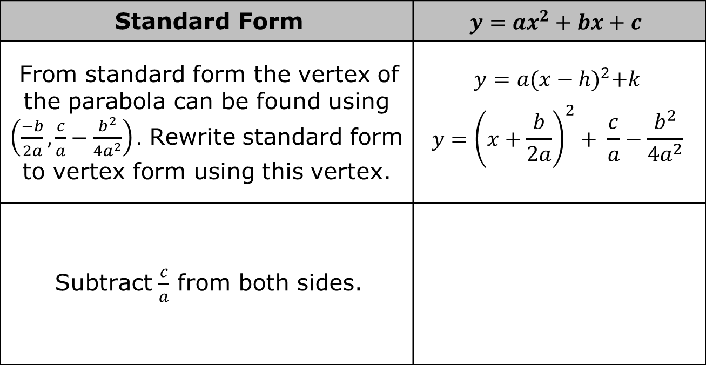
Complete the table for isolating the variable 𝑥 in standard form.
Standard Form | $$y=ax^{2}+bx+c$$
From standard form the vertex of the parabola can be found using $\left(\frac{−b}{2a},\frac{c}{a}−\frac{b^{2}}{4a^{2}}\right).$ Rewrite standard form to vertex form using this vertex. | $y=a{(x−h)}^{2}+k$ $$y={\left(x+\frac{b}{2a}\right)}^{2}+ \frac{c}{a}−\frac{b^{2}}{4a^{2}}$$
Subtract $\frac{c}{a}$ from both sides.
volume 2, pg. 102

Slide 22
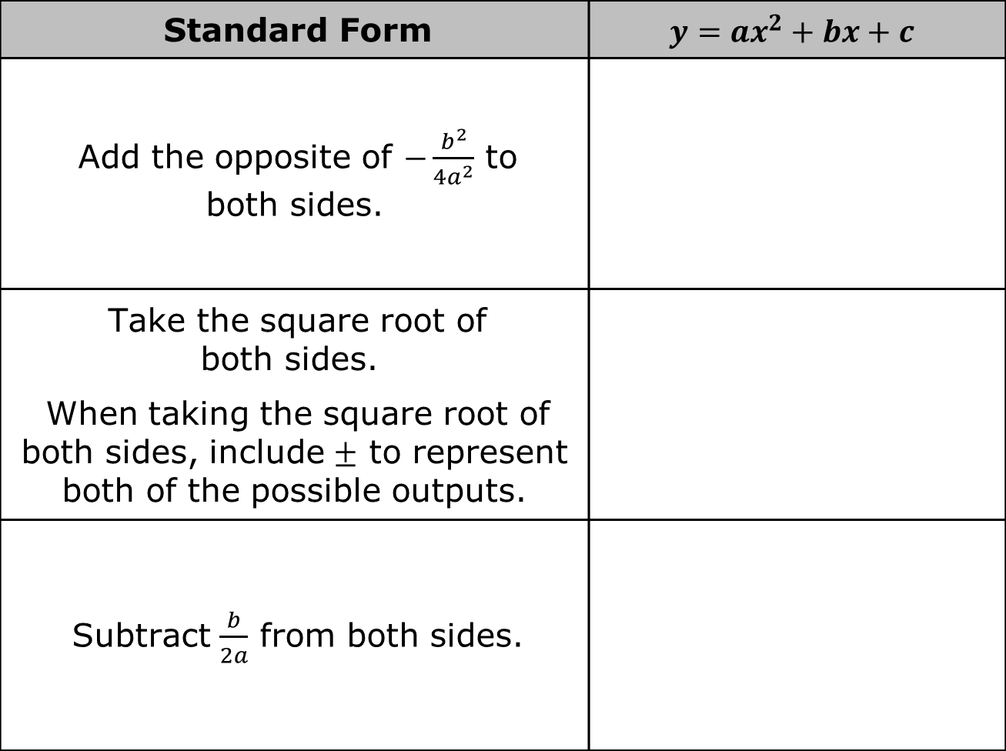
Standard Form | $$y=ax^{2}+bx+c$$
Add the opposite of $−\frac{b^{2}}{4a^{2}}$ to both sides.
Take the square root of both sides. When taking the square root of both sides, include $±$ to represent both of the possible outputs.
Subtract $\frac{b}{2a}$ from both sides.
volume 2, pg. 102

Slide 23

Wrap-Up
volume 2, pg. 102

Slide 24
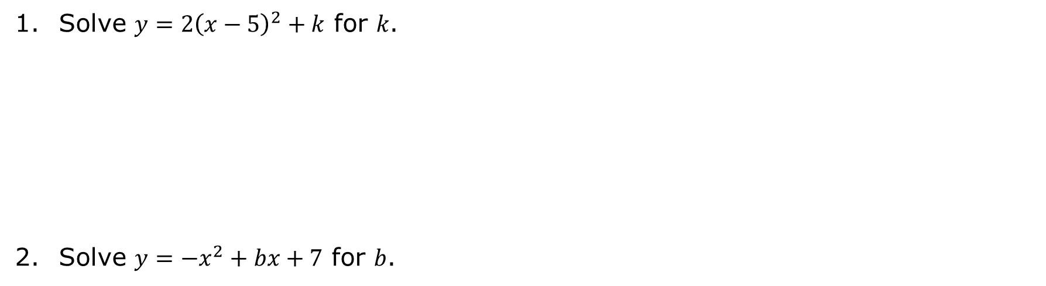
9.8.5 Wrap-Up: Ticket Out the Door
Solve $y=2{\left(x−5\right)}^{2}+k$ for 𝑘.
Solve $y=−x^{2}+bx+7$ for 𝑏.
volume 2, pg. 102

